Slide 1
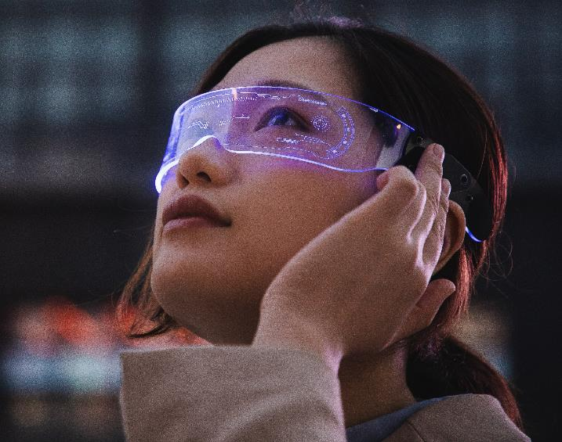
Facial Emotion
Atif Malik & Ahsan Ali

Slide 2
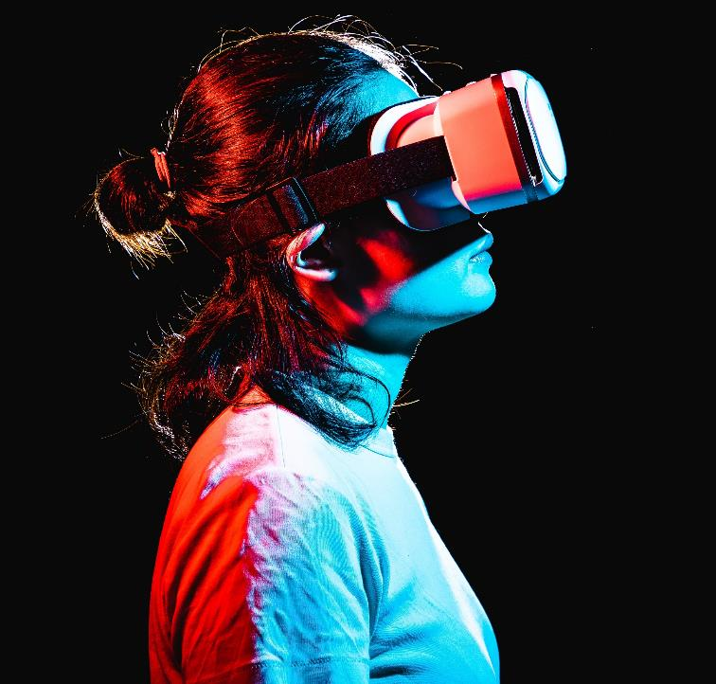
About us
Facial Emotion Recognition combines technology and human expression to understand emotions better. Our team is interested in this field because we are curious about it and want to help society.

Slide 3
The Challenge of Facial Emotion Recognition
Humans naturally interpret facial expressions to understand emotions.
Machines face challenges in accurately recognizing and interpreting diverse facial expressions.
Current methods often struggle with real-time processing and robustness across different individuals and cultural backgrounds.

Slide 4
Importance of Facial Emotion Recognition
Applications and Impact
Human-Computer Interaction: Improve interaction between humans and machines.
Mental Health: Assist in detecting mental health conditions based on facial expressions.
Marketing and User Experience: Enhance product and service design based on customer emotions.

Slide 5




Project Overview
Real-Time Recognition
Data Collection
Preprocessing
Model Training
Gathering a diverse dataset of facial expressions.
Cleaning and preparing data for machine learning models.
Using machine learning algorithms to train the model.
Implementing the model for real-time facial emotion recognition.

Slide 6




Libraries
OpenCV
Tensor flow
NUmpy
Matplotlib
It provides tools for face detection
offers tools for building and training deep learning models, which can be applied to facial emotion recognition.
handling and manipulating numerical data
useful for visualizing data and results,

Slide 7
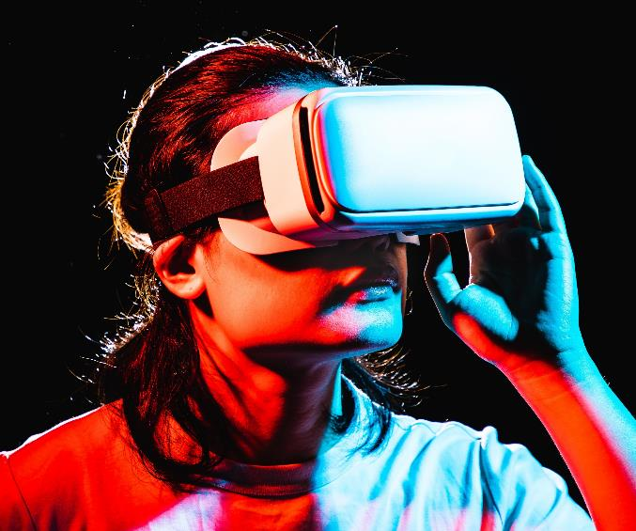
Behind the Scenes
Model Architecture: Overview of the selected model.
Open Face
VGG-Face
DeepFace

Slide 8
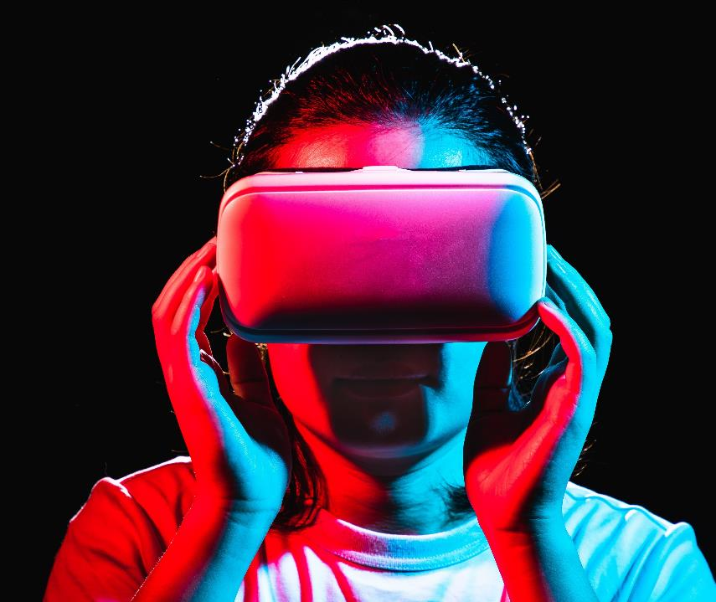
Thank you

